Slide 1
HTN management
HTN stage
HTN stage
HTN stage
HTN stage
HTN stage
HTN stage
Dr Kamran Mohammadi
Assistant Professor of cardiology
Fellowship of echocardiography
Tabriz Shahid Madani Heart Center

Slide 2
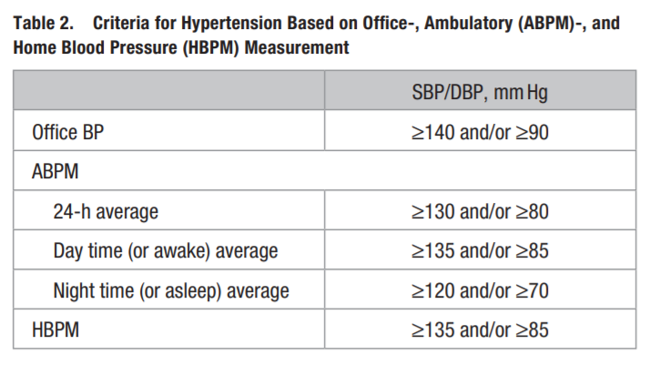
HTN stage
HTN criteria
HTN stage
HTN stage
HTN stage
HTN stage

Slide 3
Classification of Hypertension Based on Office Blood Pressure (BP) Measurement
HTN stage
HTN stage
HTN stage
HTN stage
HTN stage
HTN stage

Slide 4
Blood tests: Na, K, Cr, lipid profile and FBS.
Urine test: Dipstick urine test.
ECG: Detection of AF, LVH and IHD.
HTN stage
Paraclinic
HTN stage
HTN stage
HTN stage
HTN criteria
Elevated serum uric acid (s-UA) is common in patients with hypertension and should be treated with diet, urate influencing drugs (losartan) or urate lowering drugs in symptomatic patients

Slide 5
Non-pharmacological
Pharmacological
Seasonal BP Variation:
BP exhibits seasonal variation with lower levels at higher temperatures and higher at lower temperatures.
Similar changes occur in people traveling from places with cold to hot temperature, or the reverse.
HTN treatment
HTN stage
HTN stage
HTN stage
HTN stage
HTN stage

Slide 6
HTN stage
HTN stage
HTN stage
HTN stage
HTN inducers
HTN stage
SSRIs:

Slide 7
BP goal
HTN stage
HTN stage
HTN stage
HTN stage
HTN stage

Slide 9
Non-pharmacological therapy: for all HTN stages
Salt reduction
Healthy diet
Healthy drinks
Moderation of alcohol consumption
Weight reduction :waist-to-height ratio less than 0.5 is recommended for all population
Smoking cessation
Regular physical activity
Reduce stress and induce mindfulness
Reduce exposure to air pollution and cold temperature: Evidence from studies support a negative effect of air pollution on blood pressure in the long-term.

Slide 10
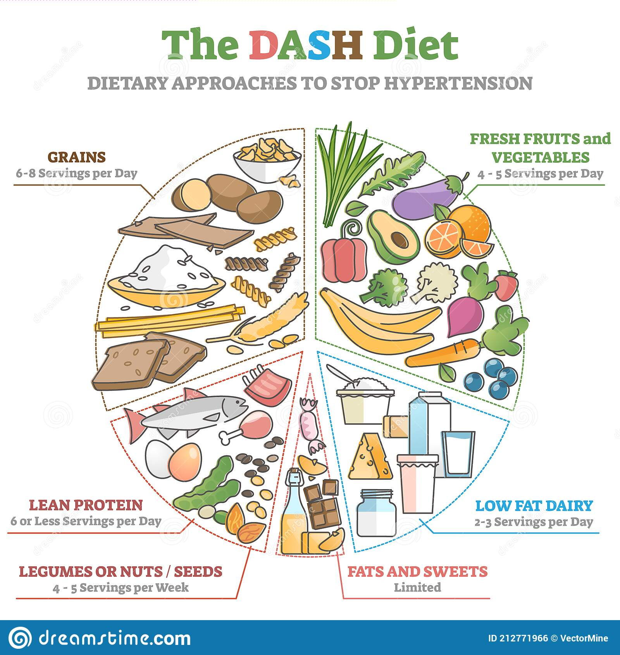
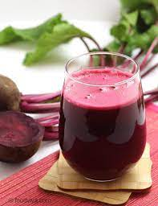
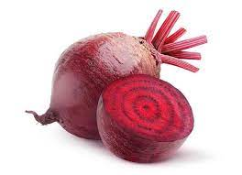
DASH diet (http://www.dashforhealth.com).
leafy vegetables and beetroot.
Moderate consumption of coffee, green and black tea. pomegranate juice, beetroot juice

Slide 11
Pharmacological Treatment
On average, less than 50% of adults with hypertension receive BP-lowering medication.
Despite the fact that a difference in BP of 20/10 mmHg is associated with a 50% difference in cardiovascular risk.

Slide 12
Response to drugs:
Each of the antihypertensive therapy classes is roughly equally effective in lowering the blood pressure.
There is wide interpatient variability as many patients will respond well to one drug but not to another.
amount of blood pressure reduction is the major determinant of reduction in cardiovascular risk in both younger and older patients with hypertension, not the choice of antihypertensive drug

Slide 13
Prediction of individual responses to drugs:
1
Race: black patients
2
Age:Older patients
Low renin state

Slide 14
Combination vs monotherapy
ACCOMPLISH trial: Combination therapy better than monotherapy.
2020 International Society of Hypertension (ISH) guidelines suggest combination therapy for most patients with blood pressure >140/90 mmHg.

Slide 15
Monotherapy indications:
Single-drug therapy reasonable in the very elderly or who have a history of hypotension.
Thiazide diuretics (especially chlorthalidone) or CCBs the best initial choice for single-drug therapy.

Slide 16
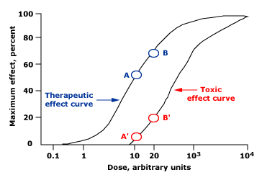
2 drugs at half-standard doses vs 1 drug at standard or twice-standard doses: which one is better?
Good responders generally respond to low doses with few side effects, while higher doses produce more side effects often with little further reduction in blood pressure

Slide 17
First line agents

Slide 18
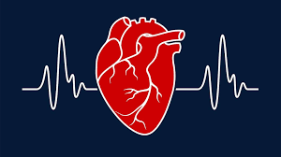
Combination therapy
BP = cardiac output × Resistance
V-drugs (Volume) : CCB or Diuretics
R-drugs(Resistance): ACEI or ARB

Slide 19
Compelling indication for diuretics
Gout: ×
Hypokalemia: ×
BPH: ×
Metabolic syndrome: ×
Osteoporosis:

Slide 20
Thiazide-like versus thiazide-type diuretics
Thiazide-like diuretics (such as chlorthalidone and indapamide) are preferred to thiazide-type diuretics:
Significantly more potent
Significantly lowered the relative risk of cardiovascular events by 12 percent and heart failure by 21 percent.

Slide 21
Thiazide therapy rules:
1) In most patients not previously treated with a thiazide diuretic, we suggest 12.5 to 25 mg/day of chlorthalidone (or 1.25 to 5 mg/day of indapamide), rather than hydrochlorothiazide.
2) Among older patients who are less than 10 mmHg above goal blood pressure, low-dose hydrochlorothiazide is a reasonable alternative.
3)Among patients already treated with low-dose hydrochlorothiazide, the optimal approach has not been defined. Some experts would switch all patients to chlorthalidone or indapamide at their next visit.

Slide 22
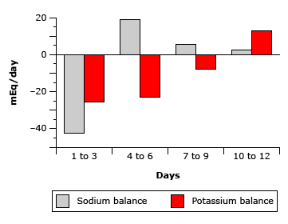
Monitoring for hypokalemia
potassium loss, occurs only during the first two weeks of therapy before a new steady state is established .
Thus, a stable patient with a normal serum K at three weeks is not at risk of late hypokalemia unless the diuretic dose is increased.

Slide 23
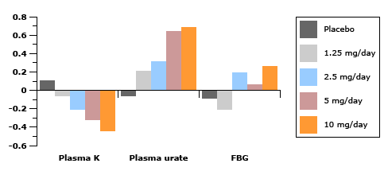
Dose dependence of thiazide-induced side effects

Slide 24
Compelling indication for ACEI and ARBs
LVH: ARB
Metabolic syn: ARB (reduces arterial stiffness)
AF: ARB
Pregnancy: ACEI, ARB ×
DM: ACEI, ARB
CKD: ACEI, ARB

Slide 25
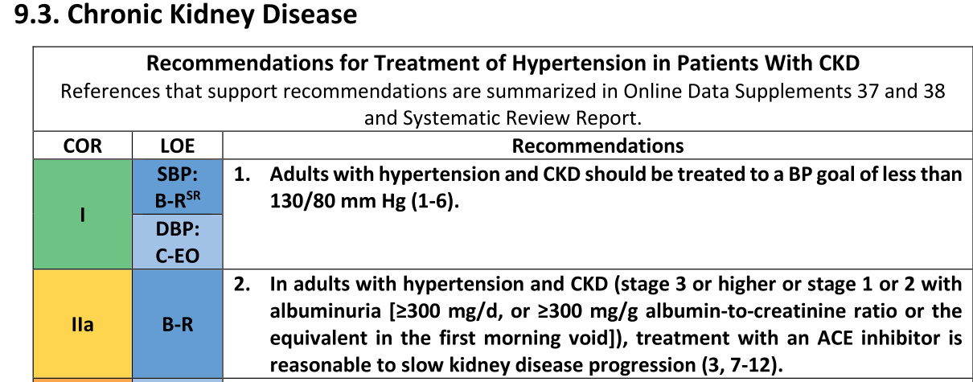
CKD

Slide 26
Serum Cr rising
In the course of reducing intraglomerular pressure, serum creatinine may increase up to 30% because of concurrent reduction in GFR

Slide 27
Compelling indication for CCBs:
HTN and edema: ×
HTN and NSAID:
HTN and older patients:
HTN and angina
HTN and renal transplantation
Most studies favor CCBs to reduce graft loss and maintain higher GFR

Slide 28
Compelling indication for β-blockers (nonatenolol β-blockers)
IHD
Arrhythmia
HF
Thoracic aortic disease (class I)

Slide 29
HTN staging based on office BP measurement.
Rutine lab tests and ECG
Nonpharmacological interventions for all patients with HTN
HTN inducers
BP treatment goal: less than 140/80
First line agents: ACEI or ARB, CCB, thiazide diuretics
HTN and β-blockers (nonatenolol β-blockers)
Combination therapy except: very elderly or those at risk or who have a history of hypotension (CCB or Diuretic)
Compelling indications

Slide 32
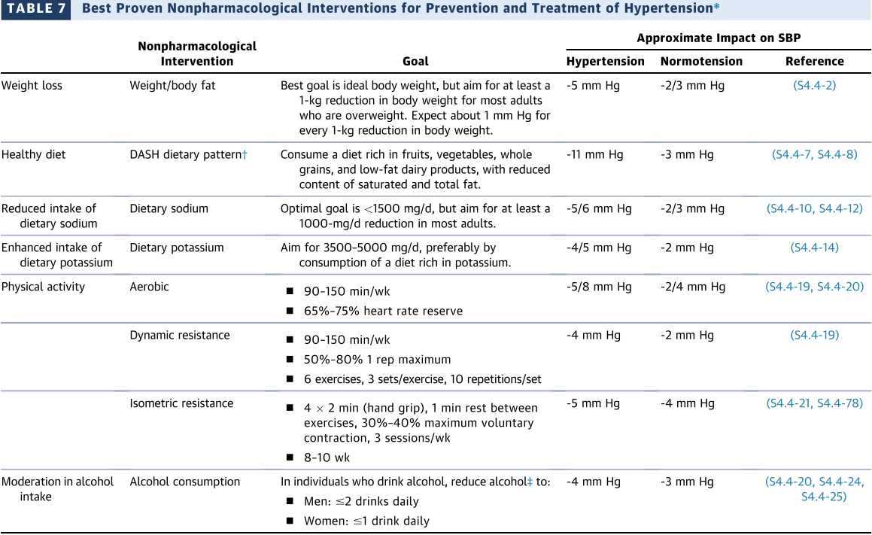
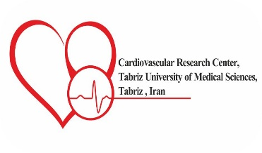
Primary Prevention in Cardiovascular Disease

Slide 33
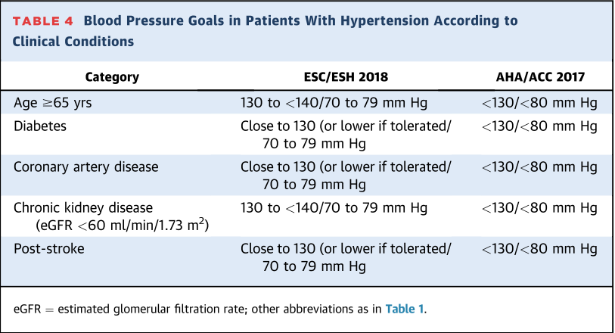
Primary Prevention in Cardiovascular Disease

Slide 34
CKD
In the course of reducing intraglomerular pressure and thereby reducing albuminuria, serum creatinine may increase up to 30% because of concurrent reduction in GFR

Slide 35
HTN and metabolic syndrome
High-dose ARB therapy reduces arterial stiffness in patients with hypertension with the metabolic syndrome.

Slide 36
HTN and β-blockers (nonatenolol β-blockers)
IHD
Arrhythmia
HF
Thoracic aortic disease

Slide 37
Combination vs single-drug therapy
single-drug therapy reasonable in the very elderly or who have a history of hypotension.
Thiazide diuretics (especially chlorthalidone) or CCBs the best initial choice for single-drug therapy.
ACEI or ARB is not recommended as a single therapy in elderly patient because of low renin level.

Slide 39
1
2
3
4
modifying or titrating oral therapy
modifying or titrating oral therapy

Slide 40
Definition and classification
Hypertensive emergency
elevations in BP (>180/120 mm Hg) associated with evidence of new or worsening target organ damage
Hypertensive urgency
elevations in BP (>180/120 mm Hg) associated without evidence of new or worsening target organ damage
The actual BP level may not be as important as the rate of BP rise

Slide 41
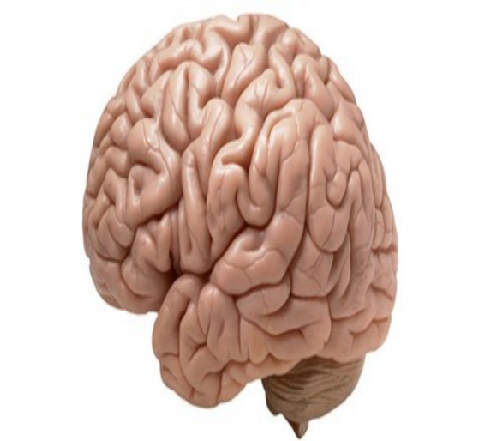
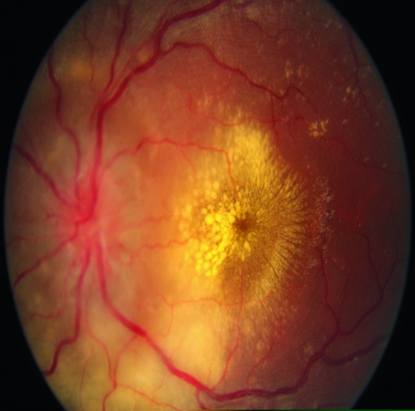
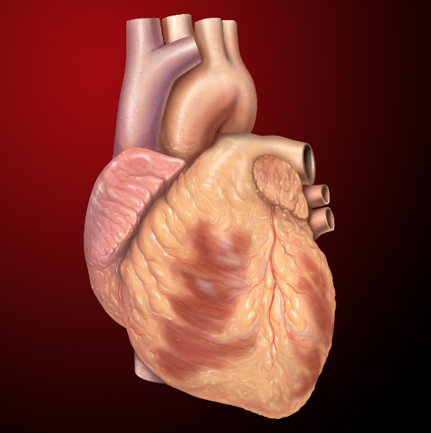
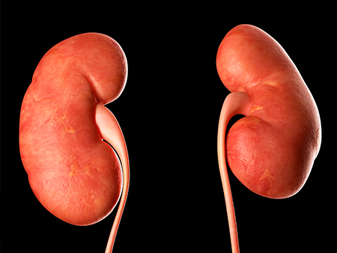
Acute target organ damage
-Hypertensive encephalopathy
-Stroke
Aortic dissection
Acute retinopathy
Acute coronary event
Acute cardiogenic pulmonary oedema
AKI

Slide 43
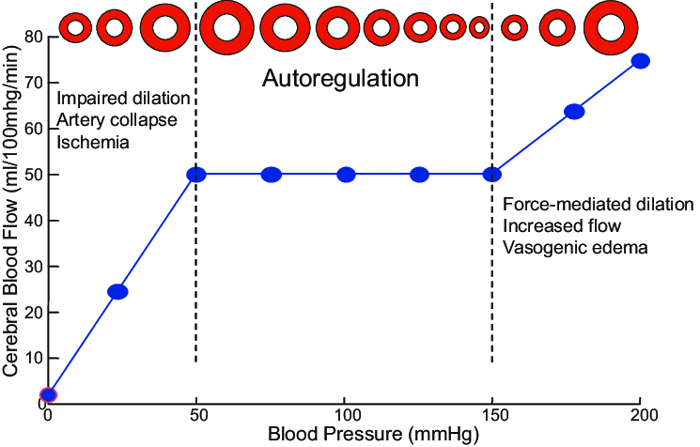

Slide 44
Acute rise in BP
Failure of vasoconstriction by auto regulation
Endothelial damage
Fibrinoid necrosis
Ischemia and RAAS activation
Hypertensive emergency pathophysiology

Slide 45
2 practical points:
Although i.v. drug administration is recommended for most hypertension emergencies, low dose of oral therapy with ACEIs, ARBs, or beta-blockers is sometimes very effective.
Furosemide

Slide 46
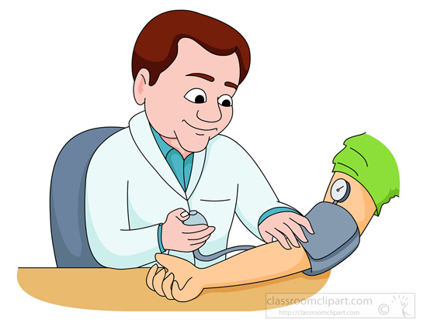

Slide 47
Common tests for all potential causes
Fundoscopy
12-lead ECG
CBC
Creatinine, electrolytes
U/A
Pregnancy test in women of child-bearing age

Slide 48
Specific tests by indication
Troponin, and NT-proBNP
Chest X-ray (fluid overload)
Echocardiography (aortic dissection, heart failure, or ischaemia)
CT angiography of thorax and/or abdomen in suspected acute aortic disease (e.g. aortic dissection)
CT or MRI brain (nervous system involvement)
Renal ultrasound (renal impairment or suspected renal artery stenosis)
Urine drug screen (suspected methamphetamine or cocaine use)

Slide 49
Treatment goal

Slide 51
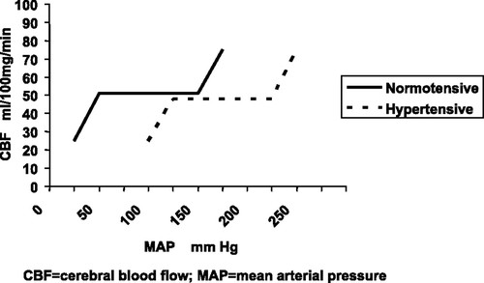

Slide 52
Time to reach blood pressure target

Slide 53
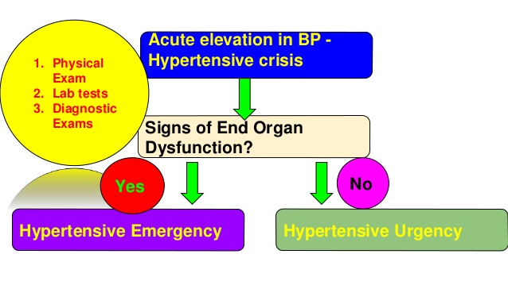
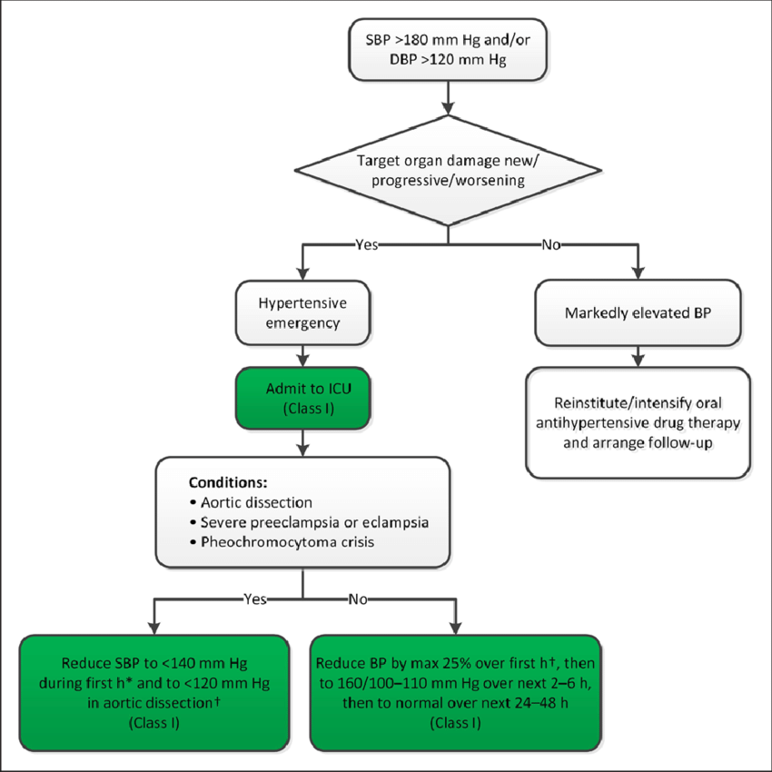
Pheo crisis
Aortic dissection
eclampsia

Slide 55
Treatment goal in aortic dissection

Slide 56
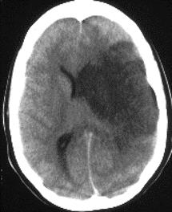
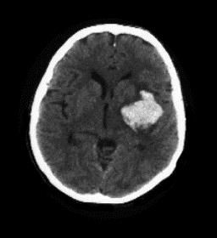
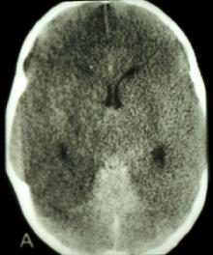
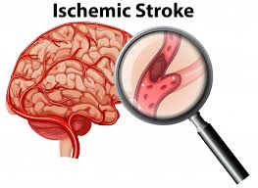
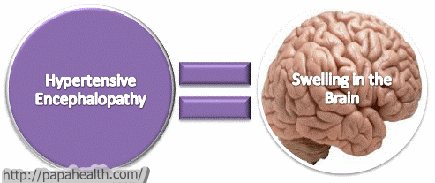
Hypertensive emergency & brain damage

Slide 58
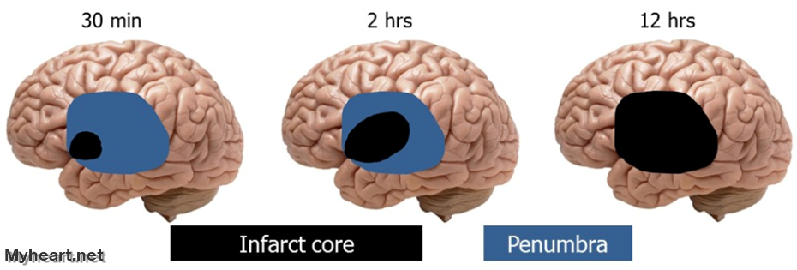
Permissive hypertension
For stable patients who remain hypertensive (≥140/90 mmHg) >3 days after an acute ischaemic stroke, initiation or reintroduction of BP-lowering medication should be considered

Slide 60
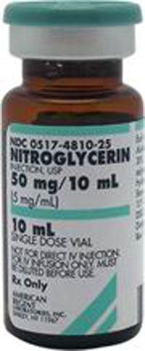
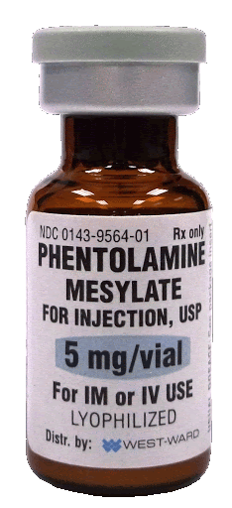
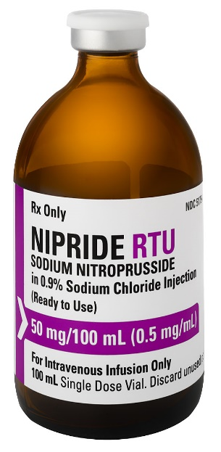
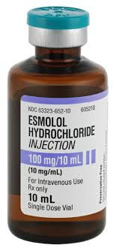
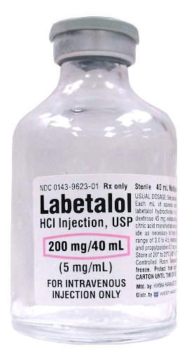
Drug of
choice
Based on EOD

Slide 61
acute MI & UA
acute LV failure with pulmonary edema
Aortic dissection

Slide 62
Acute coronary event (potential for inducing coronary steal)

Slide 63
acute LV failure with pulmonary edema
0.25–0.5 mg/kg i.v. bolus; 2–4 mg/min infusion until goal BP is reached

Slide 64
Prognosis and follow-up
The survival of patients with hypertension emergencies has improved dramatically over past decades, but these patients remain at high risk and should be screened for secondary hypertension.
frequent, at least monthly, visits

Slide 65
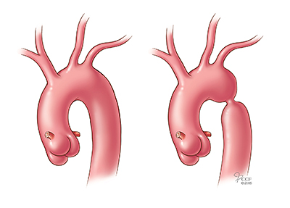
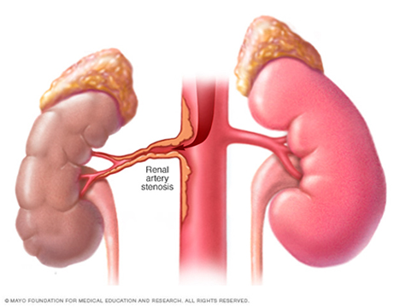
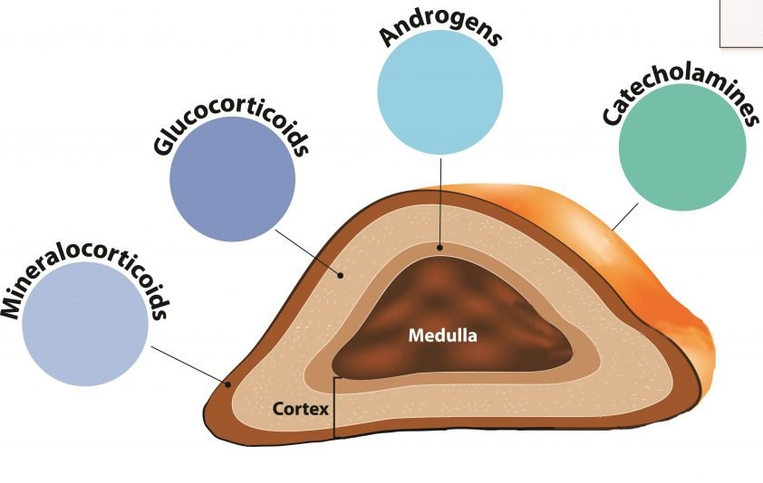
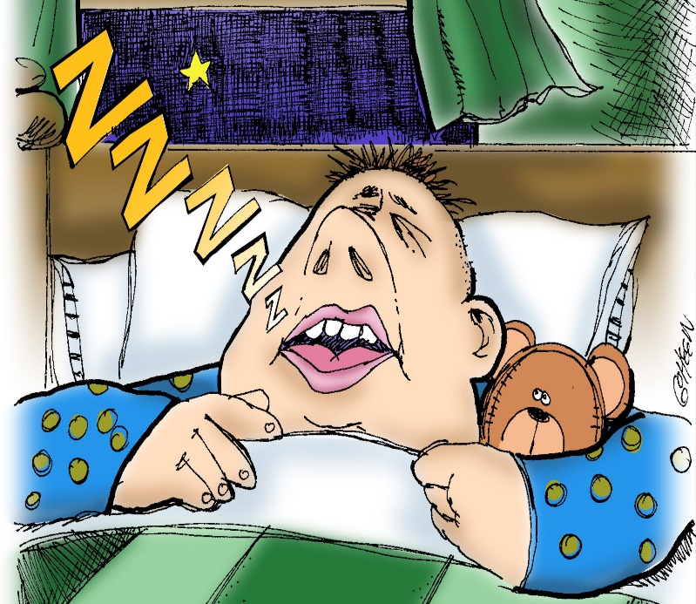
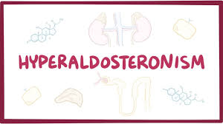
Renal + Adrenal + 2

Slide 66
Use the terms of hypertensive emergency and urgency instead of HTN crisis.
Evaluation of acute TOD.
Hypertensive emergency: ICU admission, IV therapy, BP should be reduced within minutes to hours, secondry cause evaluation
Hypertensive urgency: No need to admission, BP should be reduced within 24 to 48 hours.

Slide 68
1
2
3
4
modifying or titrating oral therapy
modifying or titrating oral therapy

Slide 70
